Slide 1
Helmet Detection And License Plate Recognition using Machine Learning
APPLICATION DOMAIN: Accident prevention
BATCH-No : 09
Guide: Dr. N.Thirupathi Rao
Assitant Professor
REGISTER NUMBERS | NAME OF STUDENTS | NO OF MEETINGS WITH GUIDE
19L31A05N9 | KARANAM JYOTHIKA
19L31A05M0 | GUMMALA JYOTHI SHANKAR SWARUP
19L31A05I5 | PUSAPATI MONITH CHAITANYA VARMA
19L31A05J1 | V RAJA VENKATA GUNNESWARA GUPTA

Slide 2
Abstract
Deep learning approach Road collisions and deaths have shot up disproportionately as motorization has grown more prevalent This study points to A means of communication to locate helmets and license plates using object detection models based on. Riders of motorbikes should put on helmets to stay out of incidents such as these. To monitor and swear to the safety of motorcycle passengers by suing their for not wearing helmets, we need a substantial traffic police force. This project utilizes YOLOv3 to locate things at three levels using deep learning, enabling helmet detection at stage two and license plate detection at level three. Whenever a license plate appears, an OCR technology uses it to extract the digits using a cropped image of the plate. Our equipment for retrieving registration plates and identifying helmets have been created utilizing the methods mentioned above. The objects detected are person, motorcycle at the first level, helmet detection at the second level, and license plate detection at a third level all using YOLOv3. The license plate is detected and a cropped image of the license plate is used to extract its digits using OCR.

Slide 3
Motivation/Origin
In India road accidents are increased very rapidly and lots of deaths are occur due to head injuries because number of peoples not wearing helmets, so to avoid the system that automatically detects the peoples who are not wearing helmet and also detect number plates of the motorcycles to penalize that persons networks. Our main motive behind Helmet and Number Plate Detection and Recognition was to first detect if someone is wearing a helmet or not, if he is wearing it, no problem, but if not, detect his number plate and send to the database.

Slide 4
Existing System
The present setup mainly utilizes CCTV documentation to monitor crashes, allowing traffic police to zoom in on the license plate in to determine where the rider is not wearing a helmet to peer into the frame where the violation has taken effect. But considering that there are so numerous accidents and more motorcycles on the road every single day, this involves a lot of effort and time. What if there were a system who would monitor for traffic infractions like riding a motorcycle or moped wearing a helmet and, if observed, would automatically extract the license plate number of the accused car. in this research the undertaking, a non-helmet rider detection system is developed in an attempt to automatically carry out the detection of the traffic violation of not wearing a helmet and the gathering of the license plate number of the Vehicle.

Slide 5
Proposed System
The proposed system uses deep learning techniques to detect helmets and license plates in images, videos, and live streaming. Specifically, we use the YOLO (You Only Look Once) object detection algorithm, which is a real-time object detection system that can detect multiple objects in an image or video. We trained the YOLO algorithm using a dataset of annotated helmet and license plate images.The Flask web framework was used to develop the website, which allows users to upload images or videos or provide a live streaming video feed.

Slide 6
System Requirements
Software Requirements
Operating System : Windows 10/Windows 11
Server-side Script : Python 3.10.9
IDE : Visual Studio Code
Libraries Used : Numpy, Flask, Keras, Wtforms, OpenCv,Tensorflow,OS
Hardware Requirements
Processor : I5/Intel Processor
RAM : 8GB (min)
Hard Disk : 128 GB

Slide 7
Modules
1 ) OpenCV: It is a well-known open-source software library used for processing images, performing computer vision tasks, and implementing machine learning algorithms. This library can be utilized for the purpose of recognizing objects, individuals, and written documents.
2) YOLO: The algorithm that uses convolutional neural networks to detect and recognize objects in real-time .it is important for its speed, accuracy, and learning capabilities.
3)Dark net: The dark web, also referred to as the darknet, is an encrypted portion of the internet that is not indexed by search engines and requires specific configuration or authorization to access. Although the dark web is sometimes portrayed as a domain frequented by criminal elements, it is also used by people who require privacy for entirely legal reasons, such as the exchange of proprietary business information or communication by political activists.

Slide 8
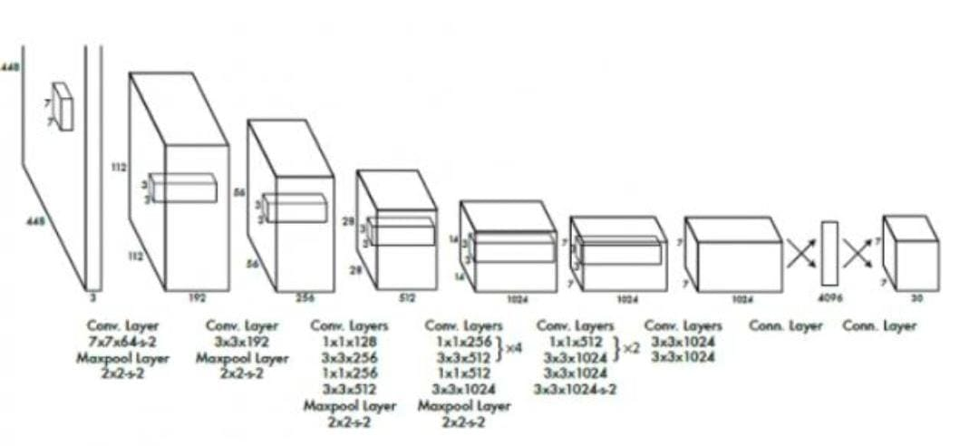
Methodology/Algorithm(s)
YOLO Algorithm:
YOLO is an abbreviation for the term ‘You Only Look Once’. This is an algorithm that detects and recognizes various objects in a picture (in real-time). Object detection in YOLO is done as a regression problem and provides the class probabilities of the detected images.YOLO algorithm employs convolutional neural networks (CNN) to detect objects in real-time. As the name suggests, the algorithm requires only a single forward propagation through a neural network to detect objects.

Slide 9
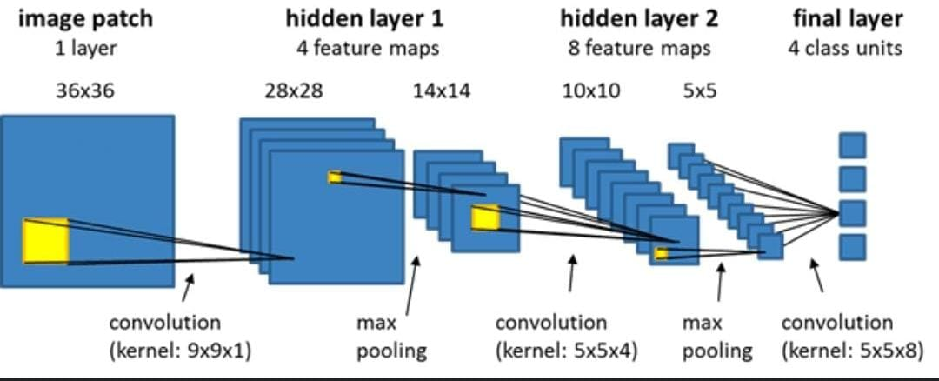
Methodology/Algorithm(s)
1. Convolutional neural network (CNN):
A convolutional neural network consists of an input layer, hidden layers and an output layer. In any feed-forward neural network, any middle layers are called hidden because their inputs and outputs are masked by the activation function and final convolution. A convolutional neural network (CNN or convnet) is a subset of machine learning. It is one of the various types of artificial neural networks which are used for different applications and data types.

Slide 10
Results
After getting the input photographs from the surveillance tape . The CNN algorithm is used to locate the people within the image who are not wearing safety helmets, and outcomes are displayed as a number plate and the license number for those who were identified. their driving license number is shown here in a red box.
The proposed model was able to accurately identify the Region of Interest (ROI) needed for image
enhancement, and a batch size of 28 was used with a subdivision reduction to 16 for faster training.
Here, there are videos who were recorded from CCTV footage. CNN algorithm is used for identifying photos, and in these uploaded videos the algorithms used recognize each frame in the video and take the frame where the two wheelers are not wearing helmets, restoring the output of the licenses number for each of the two-wheelers in the video who are not wearing helmets. following this procedure, the all the permission numbers to earn those who were two-wheelers are displayed in the red box who are not wearing helmets.

Slide 11
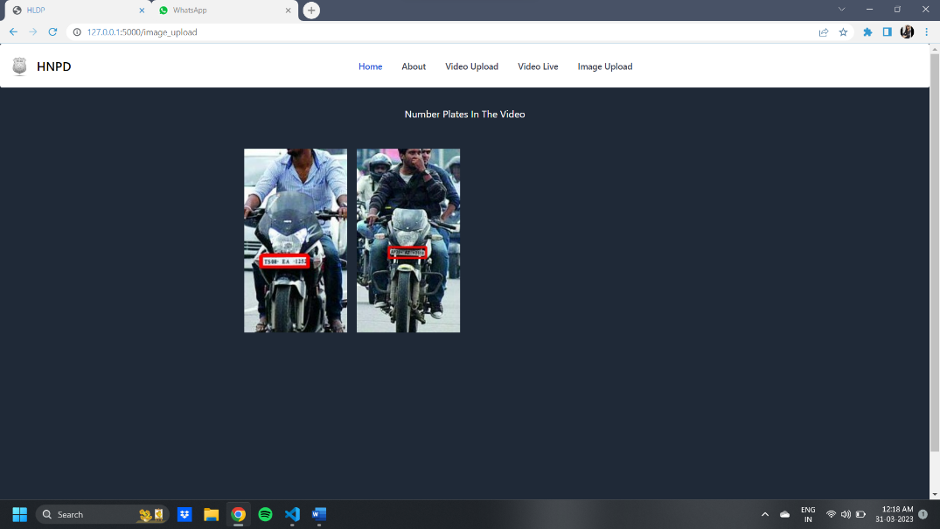
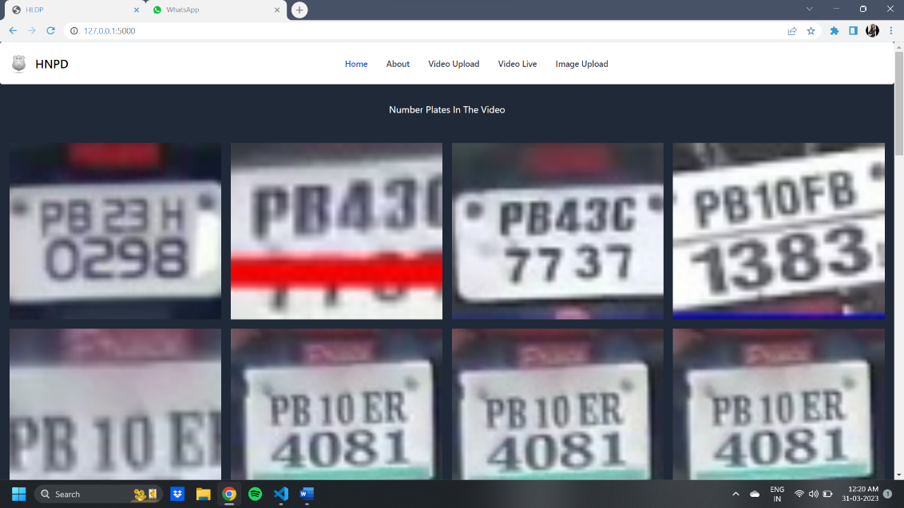
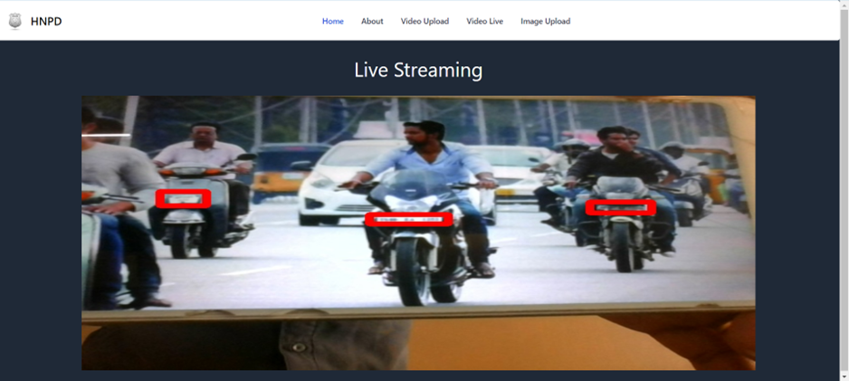
Output Screen(s)
Output of image upload
Output of video upload
Output of Live streaming

Slide 12
Time Line
Stages | Time required
1. Problem identification and definition | 1 Week
2. Collection of the related articles and requirements | 1 Week
3. Contact guide and industrial people for designing | 2 Weeks
4. Building a model for proposed work | 2 Weeks
5. Implementation, Testing, Results and Analysis | 3 Weeks
6. Thesis, preparation and submission. | 1 Week
DEPARTMENT OF CSE

Slide 13
References
[1]. J. Chiverton, “Helmet Presence Classification with Motorcycle Detection and Tracking”, IET Intelligent Transport Systems ,Vol. 6, Issue 3, pp. 259–269, March 2012.
[2].rattapoom Waranusast, Nannaphat Bundon, Vasan Timtong and Chainarong Tangnoi, “Machine Visiontechniques for Motorcycle Safety Helmet Detection”, 28th International Conference on Image and Vision Computing New Zealand, pp 35-40, IVCNZ 2013.
[3]. Romuere ilva, Kelson Aires, Thiago antos, Kalyf A dala, Rodrigo Veras, Andr e oares, “Automatic Detection Of Motorcyclists without Helmet”, 2013 XXXIX Latin America Computing Conference (CLEI). IEEE, 2013.
[4]. Romuere ilva, “Helmet Detection on Motorcyclists Using Image Descriptors and Classifiers”, 27th IBGRAPI Conference on Graphics, Patterns and Images.IEEE, 2014.
[5]. Thepnimit Marayatr, Pinit Kumhom, “Motorcyclist‟s Helmet Wearing Detection Using Image Processing”, Advanced Materials Research Vol 931- 932, pp. 588-592, May-2014.

